Slide 1

G6: Substation and Distribution Automation
Northwest Workforce Training
Washington State University
University of Washington

Slide 2

Course Outline
Module 1: Development of the modern distribution systems
Module 2: Modeling of distribution level components
Module 3: Distribution level power flow
Module 4: Voltage control devices
Module 5: Substation design and automation
Module 6: Volt-VAR optimization
Module 7: Energy storage and electric vehicles
Module 8: Demand response
Module 9: Automated switching and reconfiguration
Module 10: Introduction to micro-grids

Slide 3
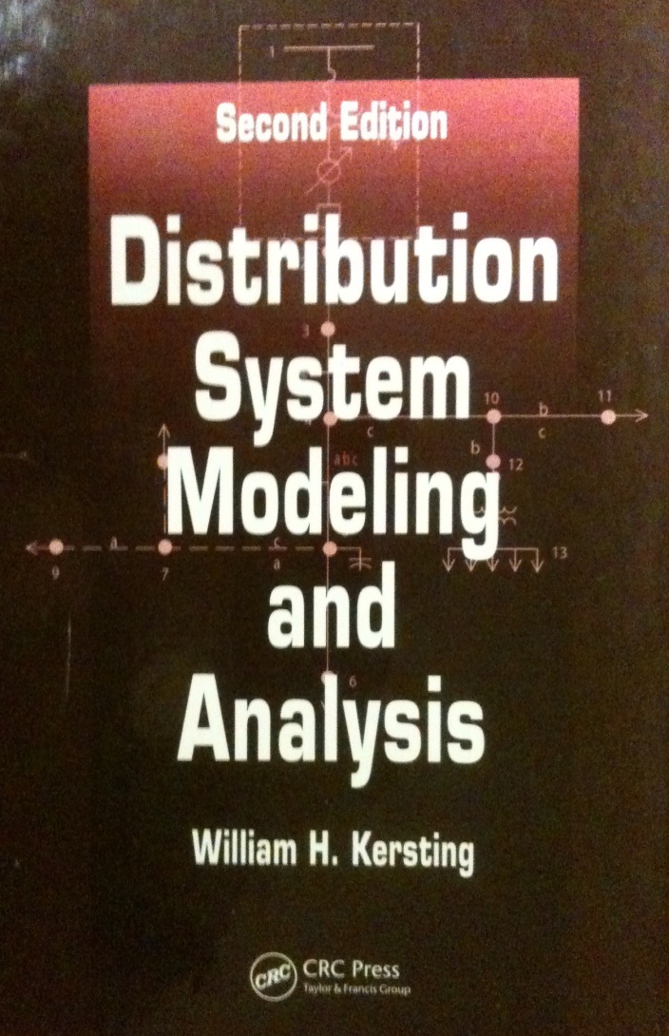
Text Book for Course
“Distribution System Modeling and Analysis”, 2nd Edition.
Additional Material
IEEE conference and journal papers
Web material

Slide 4
Course Grading
Course material
10 Homework assignments (10 questions each)
1 final exam (20 questions)
Grading breakdown
Homework: 60%
Final Exam: 40%

